Slide 1



Investigating Confidence to Optimize Student Performance
Team: Babbitt’s Bioinformaticians
Dan Coplan, Sam Kopelev, Lilly Rowland, Sam Tran
DataFest March 24, 2024
Notes:
How does confidence relate to and affect student performance?

Slide 2
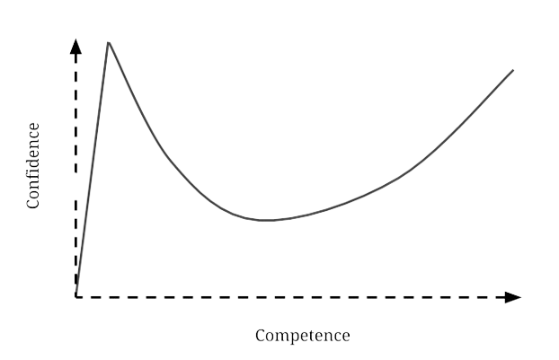
The Dunning-Kruger Effect
Notes:
Novice students tend to overestimate themselves- they don’t know how much they don’t know
Once students come to an understanding of how much they don’t understand, there is a sharp decrease in confidence
Confidence gradually increases after this sharp decline
We looked at engagement/eoc scores to characterize overconfident students and divide the data into subgroups
Credit: https://nesslabs.com/dunning-kruger-effect

Slide 3
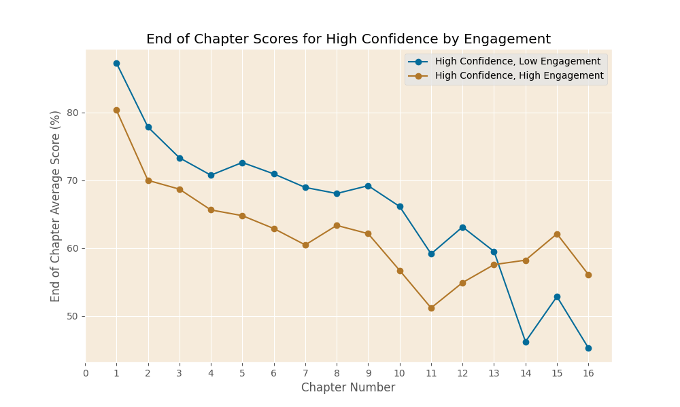
Notes:
Students with higher engagement see an increase in scores after chapter 11
Students with low engagement see a sharp decline in scores in later chapters
Method:
Engagement = time with the coursebook (clicking or scrolling)
After two minutes of idleness, the engagement timer was stopped.
Engagement was separated by quantiles
SUBSET: Students who responded “Strongly agree” to the statement “I am confident in what I learned in the previous chapter,”.
Findings:
At first: High confidence scores + low engagement outperformed those with high confidence and high engagement
Students with lower engagement →deeper familiarity with the material → less perceived need for study
Low engagement students have a sharp decline in score, and high engagement students increase their score.
interesting shift occurs at chapter 11: students with higher engagement levels start to improve
By chapter 13, students with higher engagement surpass their low-engagement counterparts, indicating that the material becomes more challenging at this point and mere familiarity with the content does not guarantee success.

Slide 4
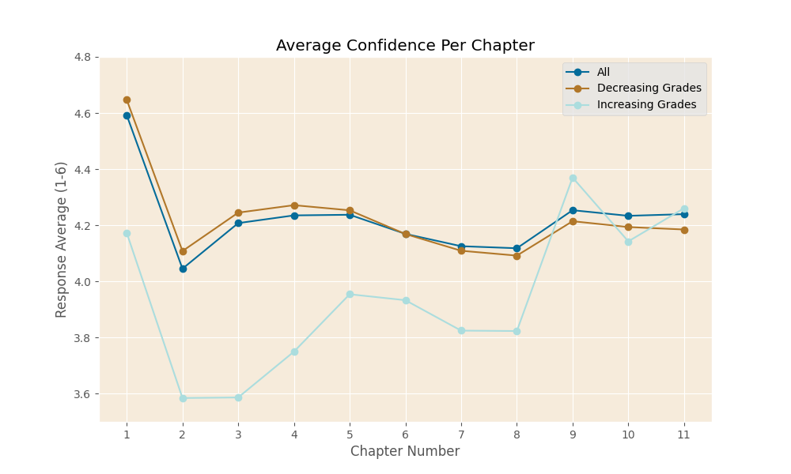
Notes:
Describe
Average student confidence per chapter by increasing or decreasing grades
Students asked: how confident they are in the material covered in the previous chapter? Ranked from 1-6.
Method
Pandas dataframe
Students subsetted based on EOC and those with increase and decrease grades
Focused on just 1-12 for best data
What we found?
Increasing grades throughout course → less confident in the material until the end of the course → confidence sharply increases.
Dunning-Kruger Effect → realization of their limitations → increase confidence as competence increases
Interplay between overconfidence, the Dunning-Kruger Effect, and academic performance.

Slide 5
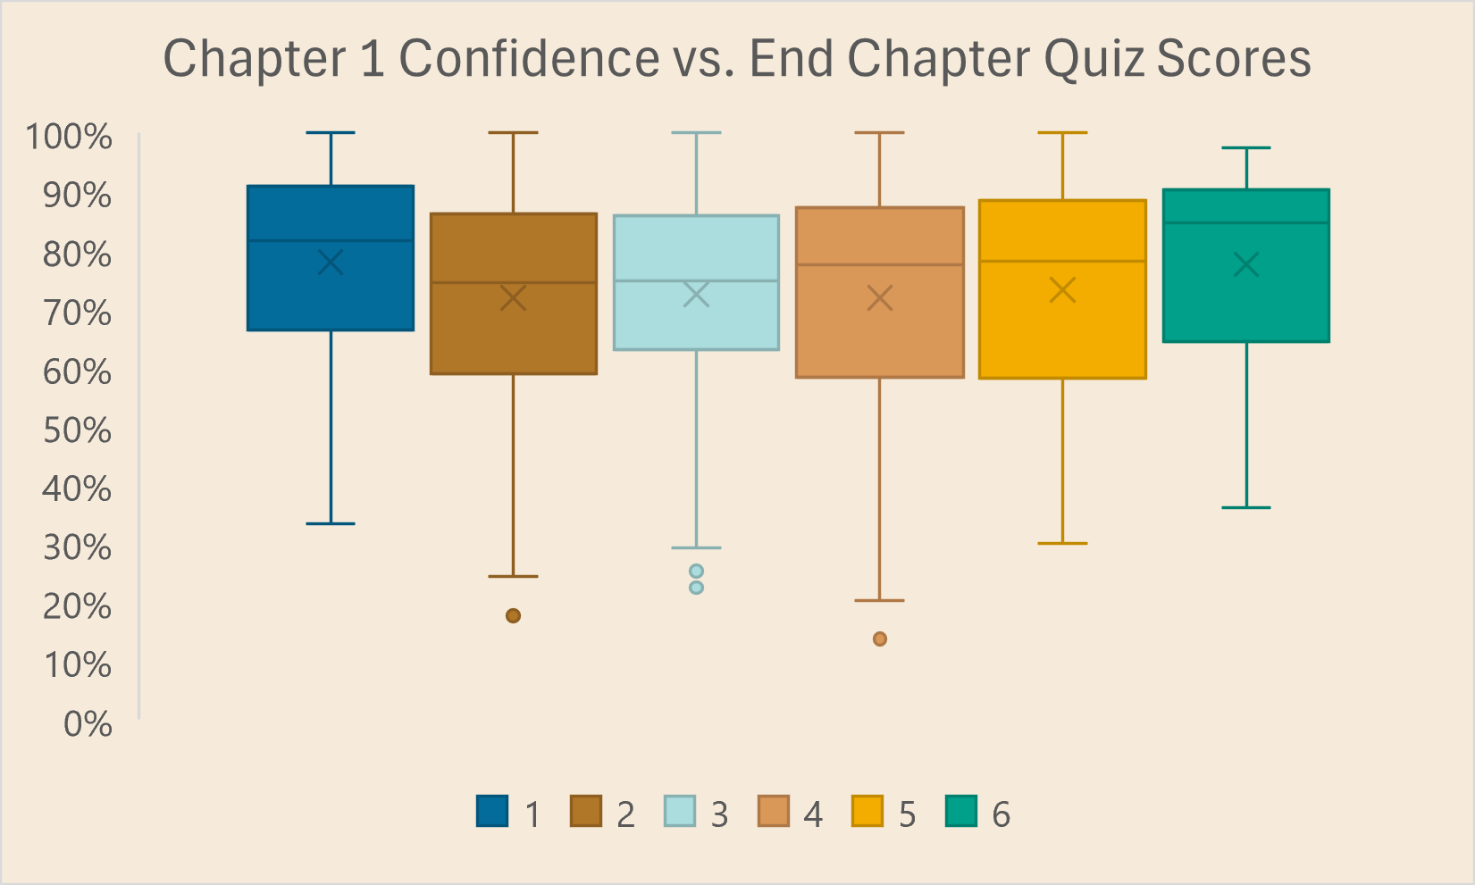
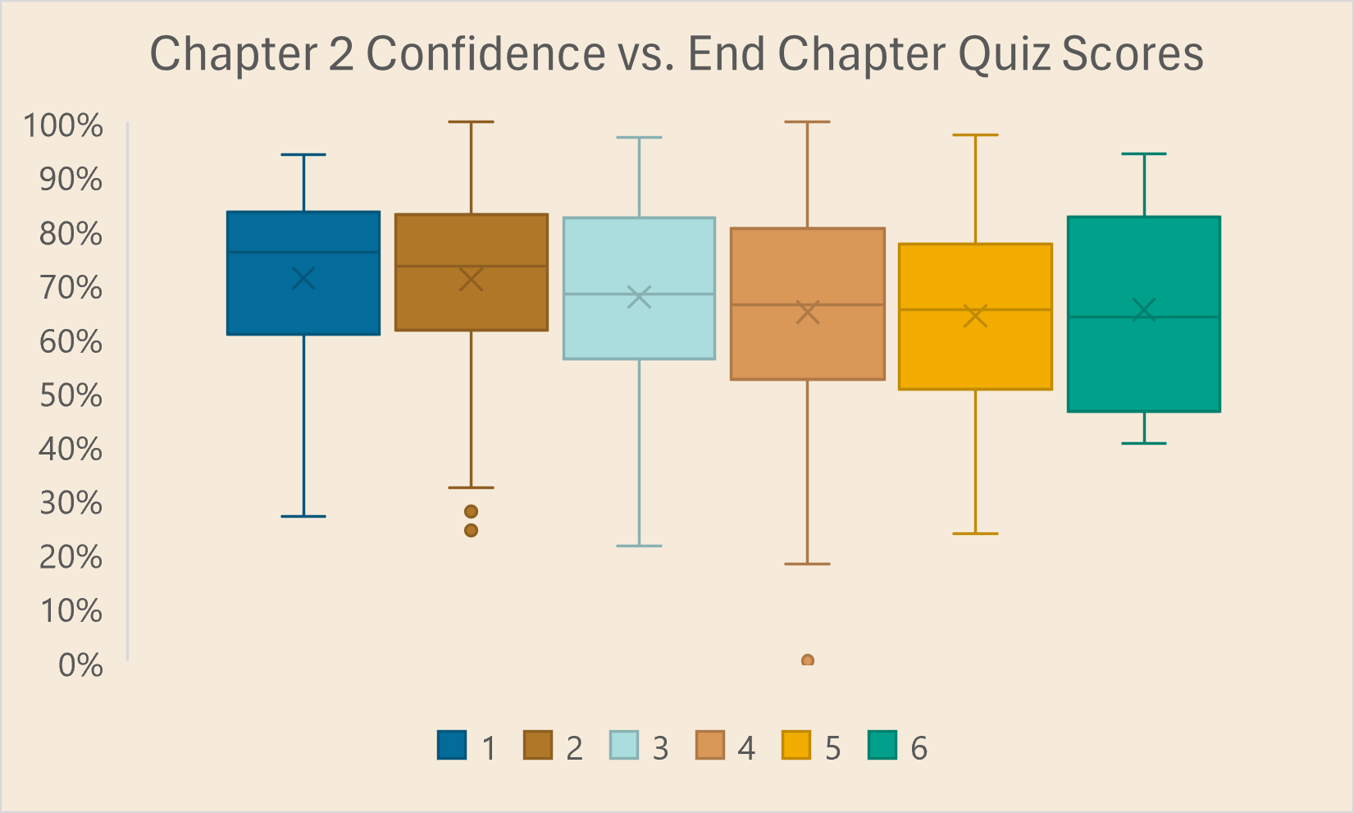
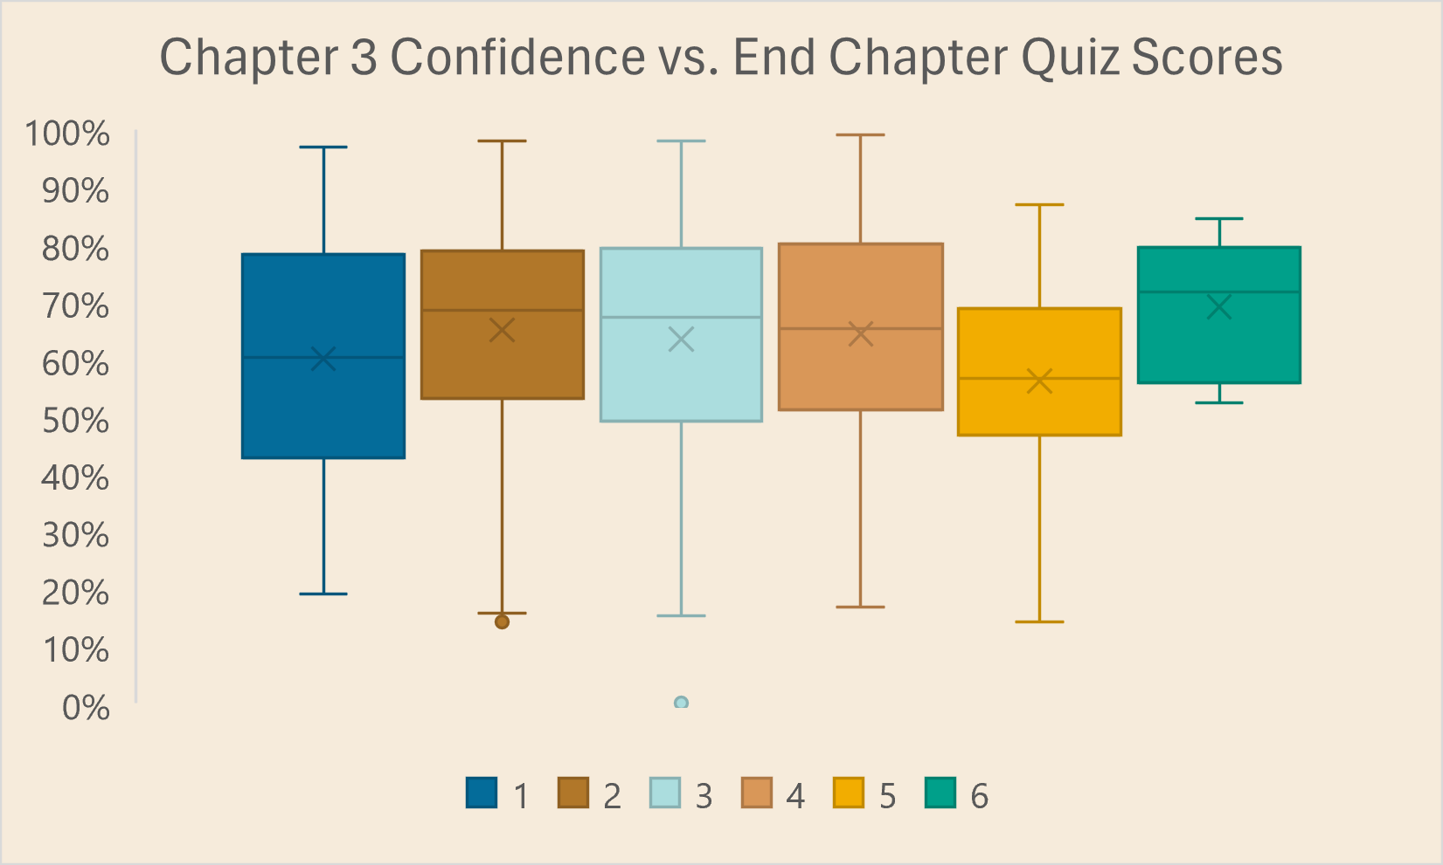
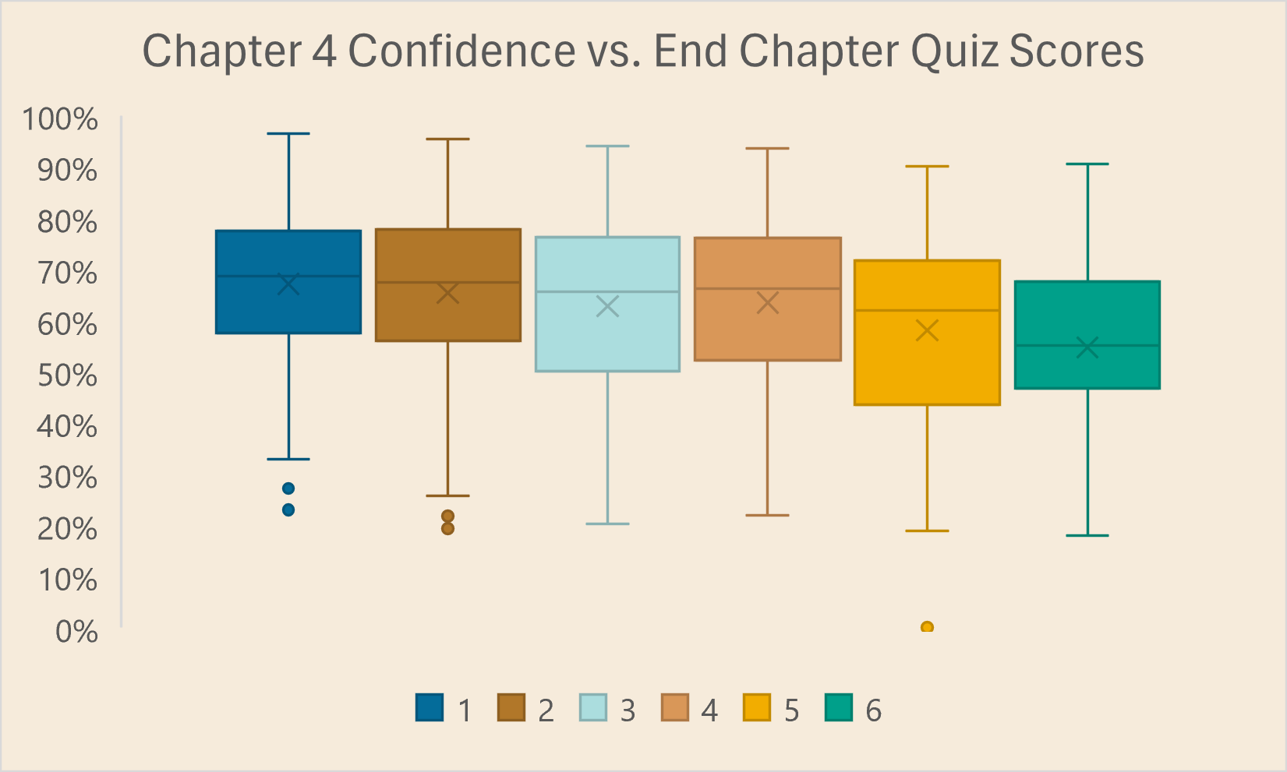
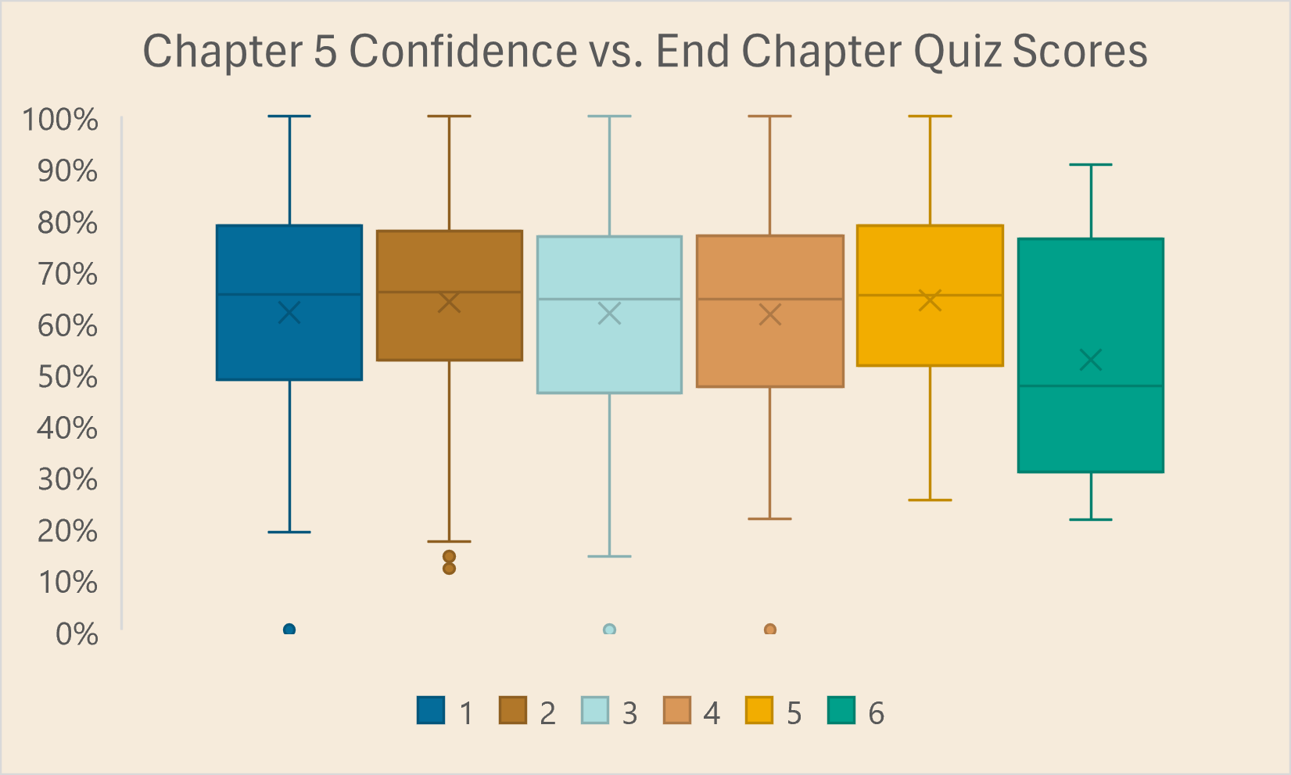
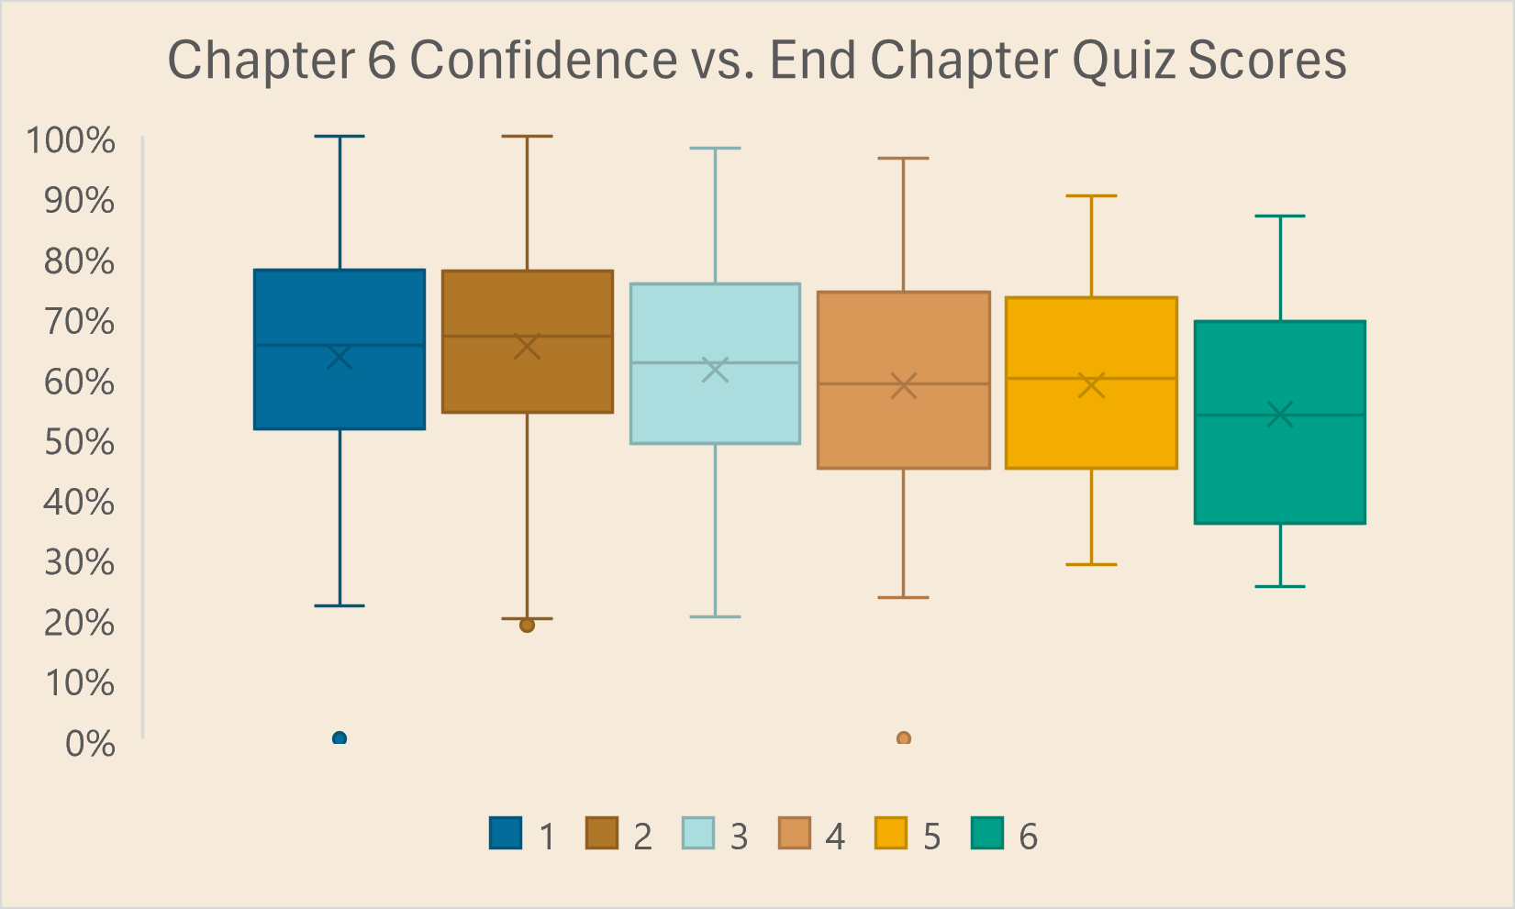
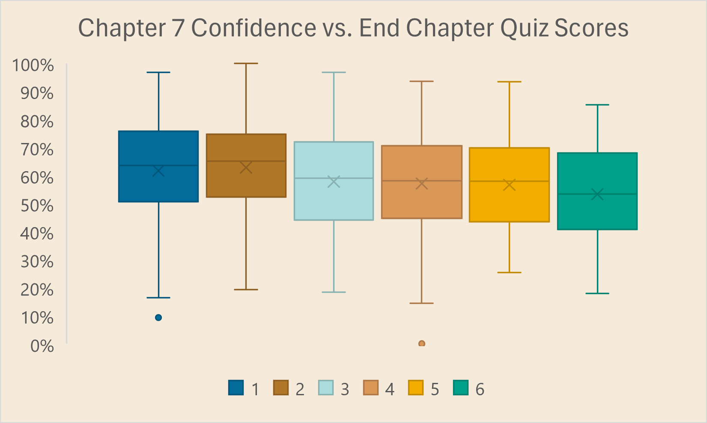
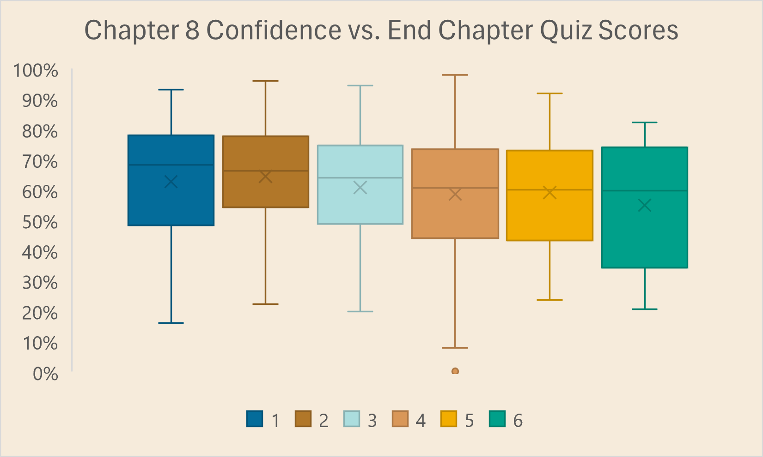
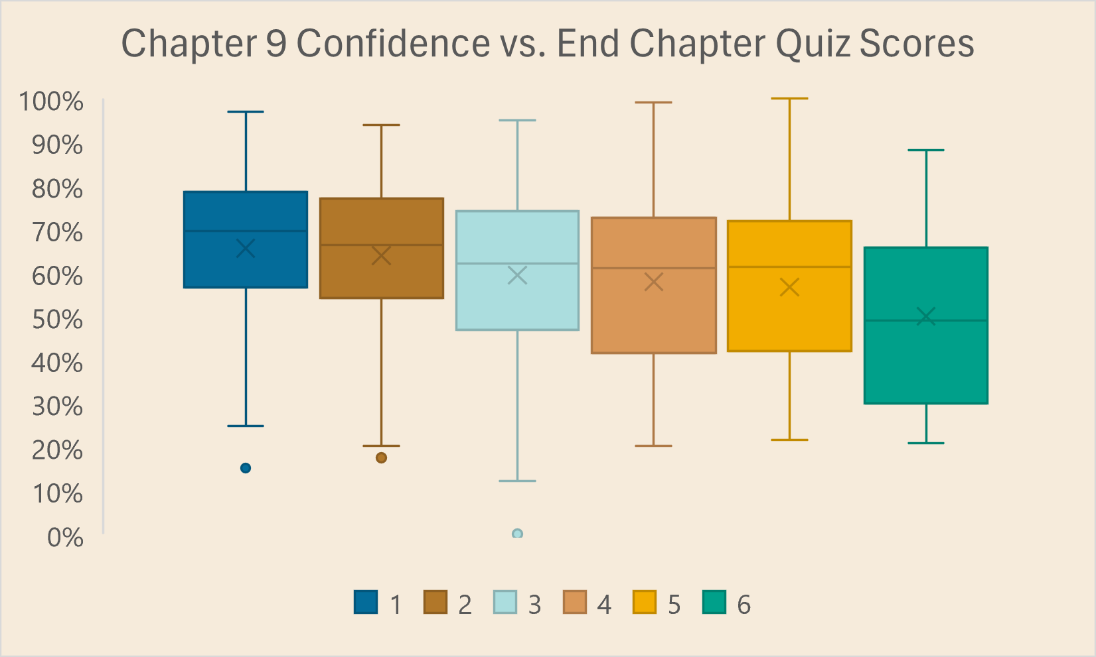
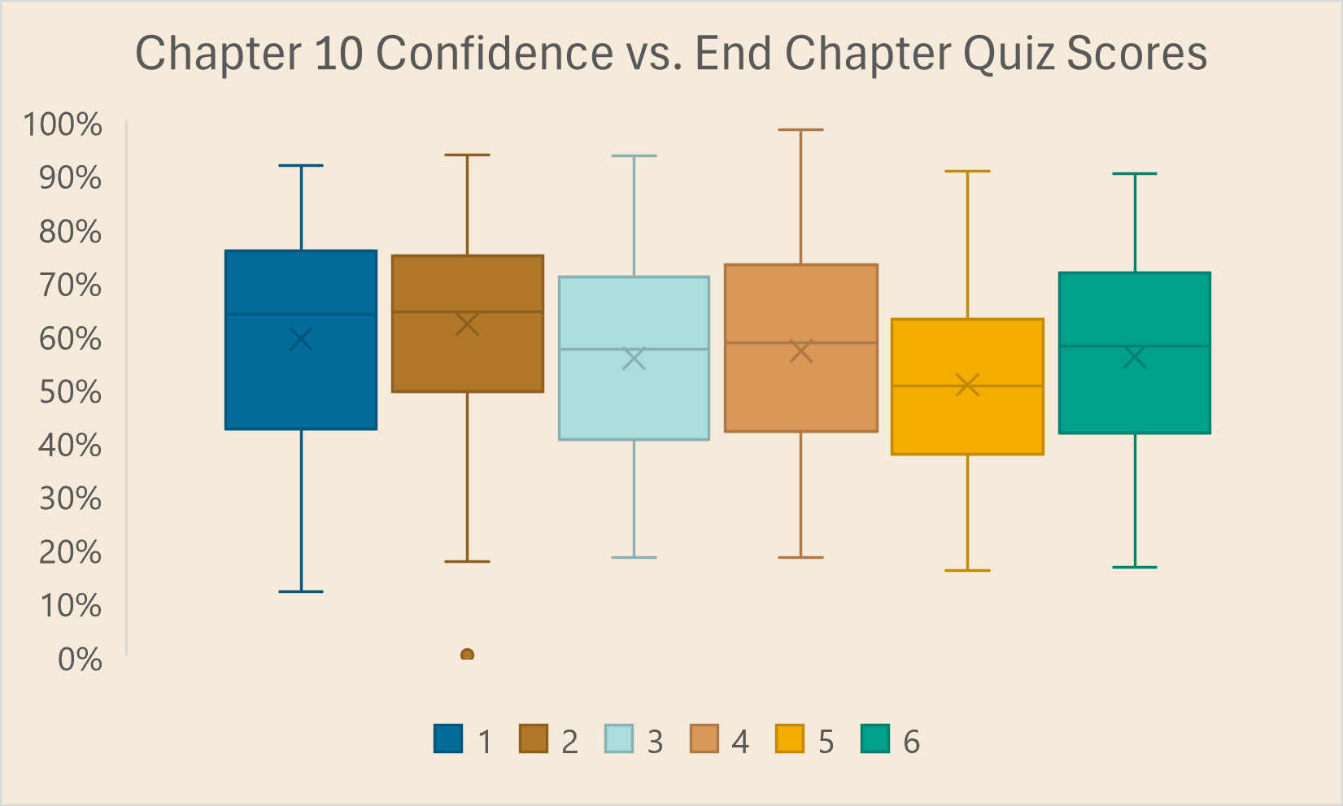
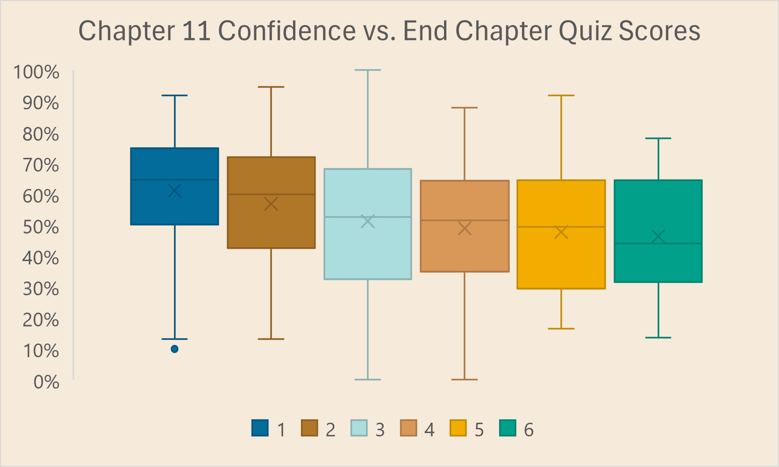
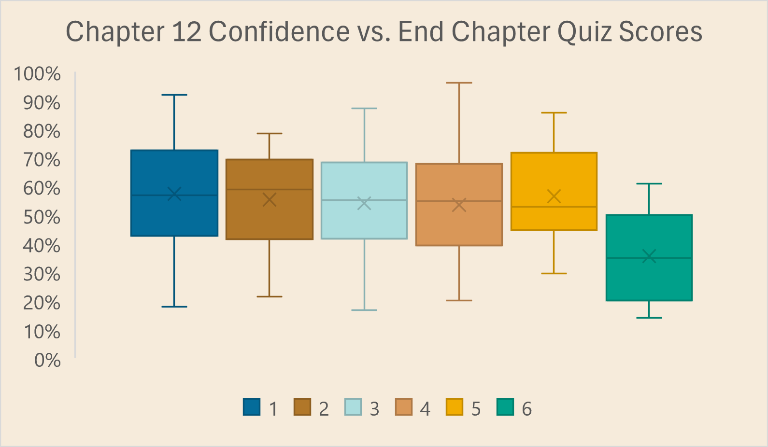
STUDENT SCORES GROUPED BY CONFIDENCE PER CHAPTER
Notes:
Speak on the trends over time (30s)
We looked over data comparing the End of chapter quiz scores broken up by student reported confidence level
As we can see, the first chapter’s quiz scores seem to have a similar distribution regardless of reported confidence level
(click) over the next 12 graphs, the confidence level starts to paint a picture of the spread around scores, with each confidence level containing relatively similar distributions for each chapter
By chapter 3, very confident students tend to receive higher scores, but after chapter 3 the confidence level seems to lose correlation with score distribution
As courses progress, the quiz score averages decrease.
One of the most interesting find is as we get to chapter 12, the most confident students received the lowest scores

Slide 6
Steps for teachers to increase engagement
1.
Mandatory Assignments
Group Assignments
Adaptable study strategies
2.
3.
Notes:
Mandatory assignments force students to engage with the material. Those who feel more confident have less incentive to review what they think they already know and don’t learn what they don’t know, so mandatory assignments force them to open their minds.
Group assignments allow students to supplement each other’s learning. Students with a better conceptual understanding are able to analyze and evaluate different models, whereas students who rely on memorization are ill-equipped to perform analysis and understanding. Those with a better conceptual understanding can help their peers connect the dots and help them apply what they know to practical problems.
Encouraging students to be flexible in the way that they learn material will help students later in the course. Students who begin the course with a fixed mindset may struggle later if they realize that their study strategies are not effective. Being able to change these study strategies and adapt to the course load is a skill that will allow students to have a deeper understanding in later chapters of the course.

Slide 7

Thank you for listening

